Slide 1
Tournament winner
2023/03/04

Slide 2
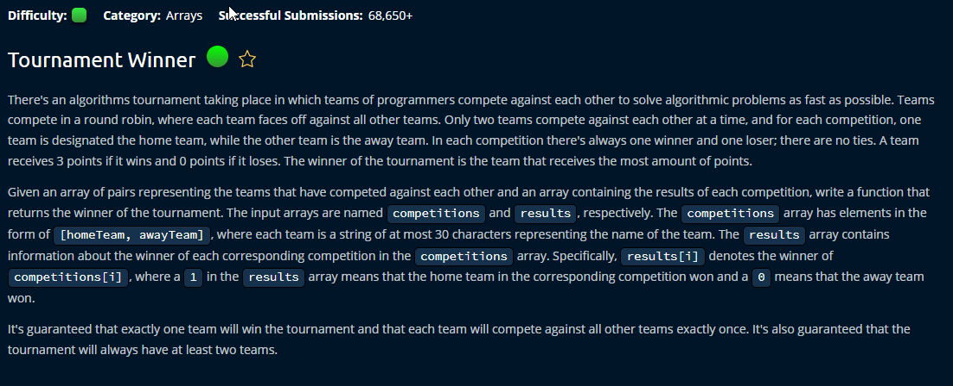

Slide 3
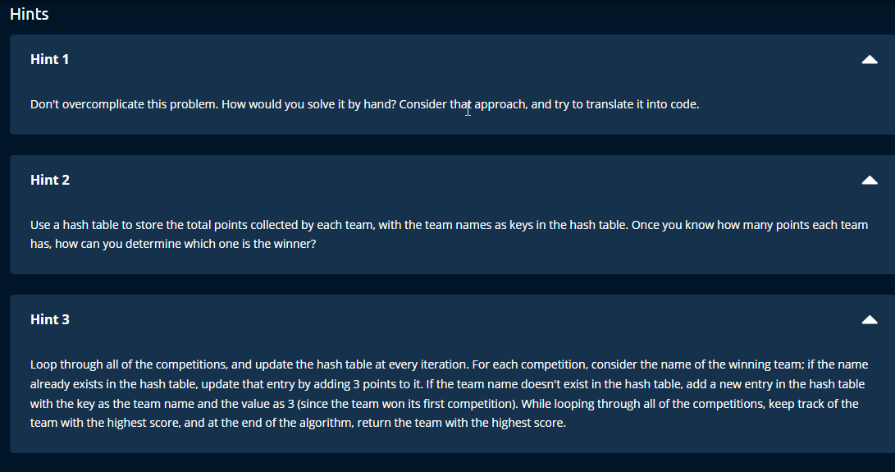

Slide 4
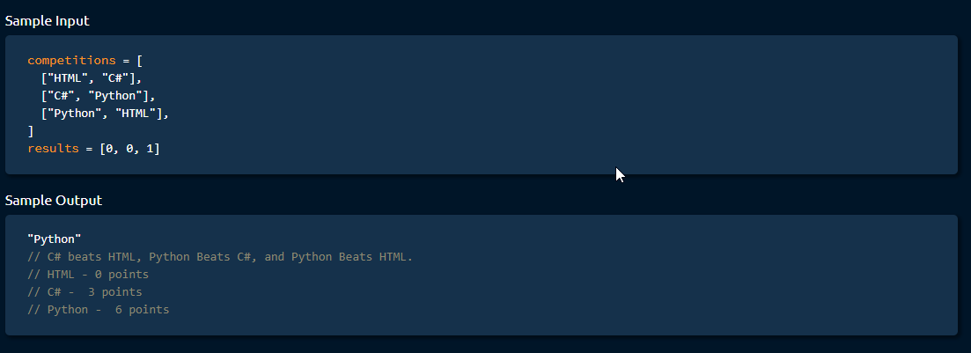

Slide 5
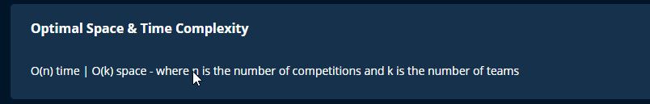

Slide 6
Space and time complexity Explanation
The time complexity of this code is O(n), where n is the number of matches played in the tournament. This is because the code iterates through each match to update the score sheet and determine the winner.
The space complexity of this code is O(t), where t is the total number of teams participating in the tournament. This is because the code creates three lists (home_teams, away_teams, and Score_sheet) that each have a length of t, and also stores the best_team variable which is a string that takes up a constant amount of space.

